Slide 1

Green Pace
Security Policy Presentation
Developer: Josh Ryther

Slide 2

OVERVIEW: DEFENSE IN DEPTH
This policy defines the core principles that will be implemented into all future applications in the company. Layers of security support defense in depth by creating multiple obstacles before gaining access to secure systems.

Slide 3
THREATS MATRIX
The threat matrix provides examples of rules that have a likelihood of occurring and the priority for remediation.
Likely STD-009-CPP | Priority STD-001-CPP
Low priority STD-006-CPP | Unlikely STD-004-CPP

Slide 4
10 PRINCIPLES
Validate Input Data: Ensure that integer conversions do not result in lost or misinterpreted data
Heed Compiler Warnings
Architect and Design for Security Policies: Do not attempt to access freed memory
Keep It Simple: Do not user floating point variables to loop counters
Default Deny
Adhere to the Principle of Least Privilege
Sanitize Data Sent to Other Systems
Practice Defense in Depth: Ensure that queries are created as set parameters
Use Effective Quality Assurance Techniques: Utilize assertions to verify pre-conditions of an application
Adopt a Secure Coding Standard: Detect and handle errors that can be thrown by third party libraries

Slide 5
CODING STANDARDS
Rule | Severity | Likelihood | Priority
Ensure that operations on signed integers do not result in overflow | High | Likely | High
Ensure that integer conversions do not result in lost or misinterpreted data | High | Likely | High
Ensure there is enough space for character data and null terminator in strings | High | Likely | High
Ensure that queries are created as set parameters. | High | Probable | High
Perform garbage collection techniques to avoid stack overflow. | High | Likely | High
Detect and handle errors that can be thrown by third party libraries | High | Likely | High
Do not attempt to access freed memory | High | Likely | High
Ensure that division operations do not divide by zero | Low | Likely | Medium
Do not user floating point variables to loop counters | Low | Likely | Low
Utilize assertions to verify pre-conditions of an application | Low | Unlikely | Low

Slide 6
ENCRYPTION POLICIES
Encryption in rest: Encryption of data that is stored
Encryption at flight: Encryption of data being transferred
Encryption in use: Encryption of data currently being accessed

Slide 7
TRIPLE-A POLICIES
Authentication: Verification of users to confirm who they are
Authorization: Access granted to users based on the system role
Accounting: Logging of actions and changes made by users

Slide 8
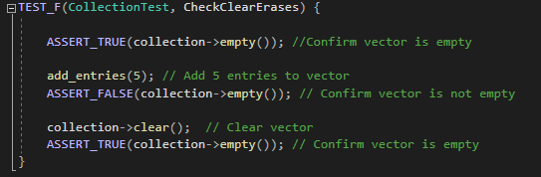
Verify clear() erases the collection

Slide 9
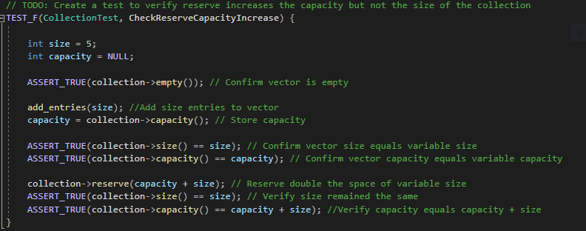
Verify reserve increases the capacity but not the size of the collection

Slide 10
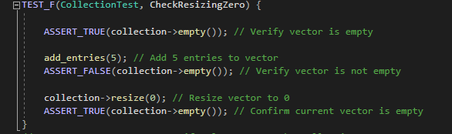
Verify resizing decreases the collection to zero

Slide 11
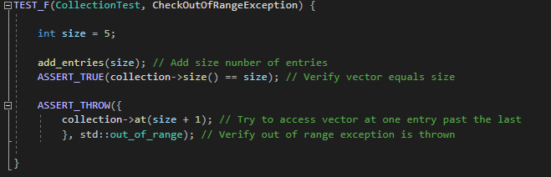
Verify the std::out_of_range exception is thrown when calling at with an index out of bound

Slide 12

AUTOMATION SUMMARY

Slide 13
TOOLS
DevSecOps Pipeline: Process of integrating security into the software development lifecycle.
Automation Tools: Security frameworks are utilized throughout the DevSecOps pipeline to design, test and monitor the application for vulnerabilities that may occur.

Slide 14
RISKS AND BENEFITS
Wait or act now to add security?
Wait – Money and time is saved allowing for further development that will enhance the capabilities of the product
Act Now – The security of the software will be enhanced which may prevent costly repercussions if vulnerabilities are exploited and data is leaked. Repercussions include that while software will be more stable it will also be behind in features that could have been implemented.

Slide 15
RECOMMENDATIONS
Gaps:
Buffer overflow
Exception handling
Input validation

Slide 16
CONCLUSIONS
Future Standard Examples:
All Strings must ensure protections are in place to detect if the number of characters to be written exceed the limits
Custom classes must utilize prebuilt or custom exceptions for common errors that may occur. All applications that utilize the exceptions need to handle them.
All data that types that can be inputted by the user must utilize input validation.

Slide 17
REFERENCES
Information Source:
Seacord, R. C. (2013). Secure Coding in C and C. [VitalSource Bookshelf]. Retrieved from https://bookshelf.vitalsource.com/#/books/9780132981972/

